Slide 1

MANIPAL SCHOOL OF INFORMATION SCIENCES (A Constituent unit of MAHE, Manipal)
ANALOG TO DIGITAL CONVERTER
Under the guidance of
Prashanth Kumar Shetty
Associate Professor - Senior Scale
Manipal School of Information Sciences,
MAHE, MANIPAL
20/1/2021
Reg. Number | Name | Branch
201038012 | Shree Jnanesh | VLSI-A
201038037 | Tummala Vamshi | VLSI-B
201038055 | Avinash R | VLSI-B

Slide 2
CONTENTS
Introduction
What is ADC ?
Types of ADC’s
Implementation
Results
References

Slide 3
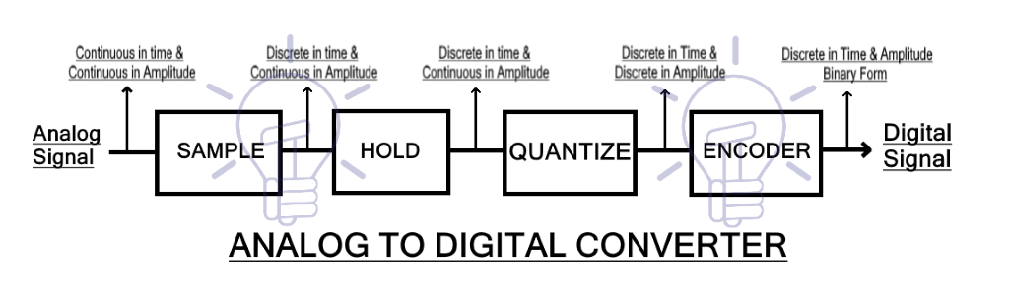
INTRODUCTION
WHAT IS ADC ?
It is a system that converts an Analog signal to a Digital signal (mostly Binary value output).
The output depends upon the coding scheme followed in the ADC circuit.
Figure 1: Basic Block Diagram of an ADC

Slide 4
Types of ADC’s
There are different Types of ADC’s
1. Direct Conversion/ Flash ADC Architecture
2. Successive Approximation ADC Architecture
3. Pipelined ADC Architecture
4. Sigma-delta ADC Architecture
5. Dual Slope ADC Architecture

Slide 5
Direct Conversion/ Flash ADC Architecture Block Diagram

Slide 6
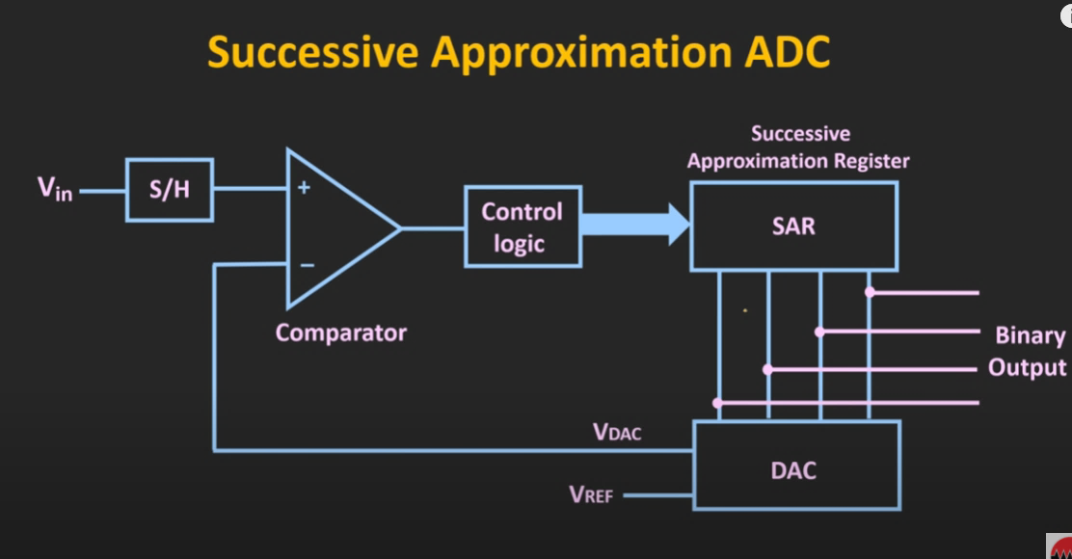
Successive-Approximation ADC Architecture Block Diagram

Slide 7
IMPLEMENTATION
Focusing upon
SAR - ADC low power consumption, high resolution and accuracy
Flash - ADC Very high-speed Low latency

Slide 8
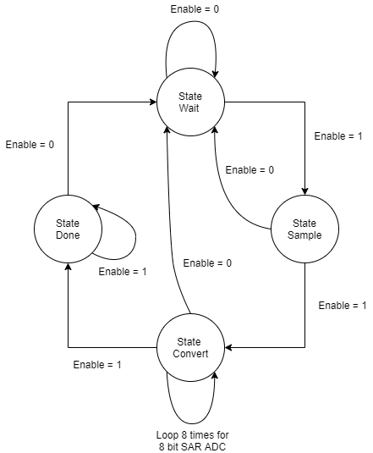
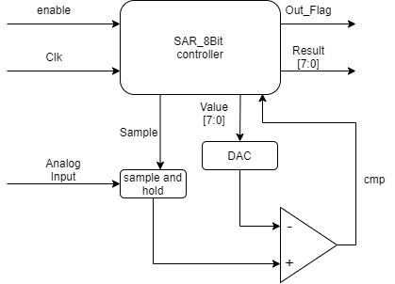
SAR ADC Implementation

Slide 9
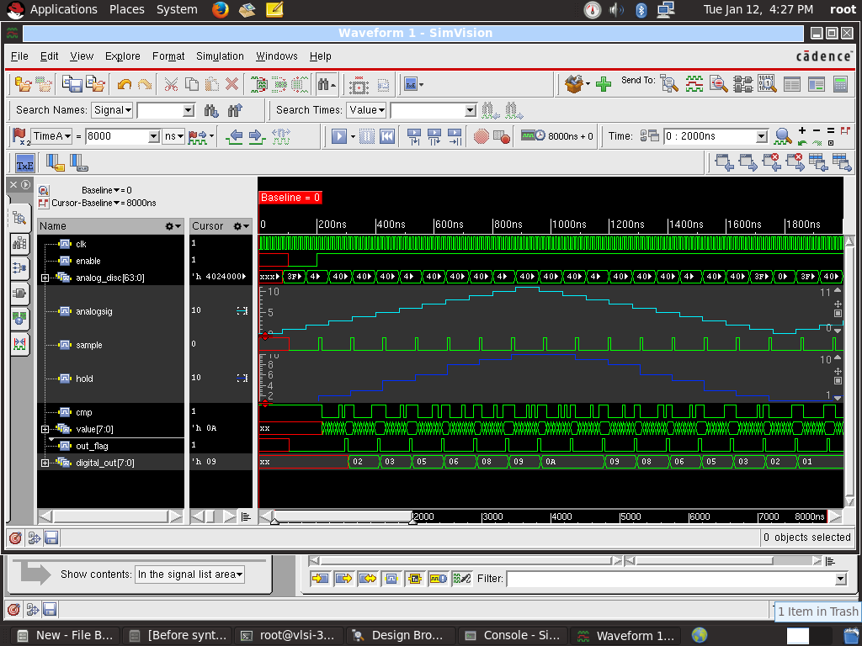
Results of SAR ADC
Before synthesis:

Slide 10
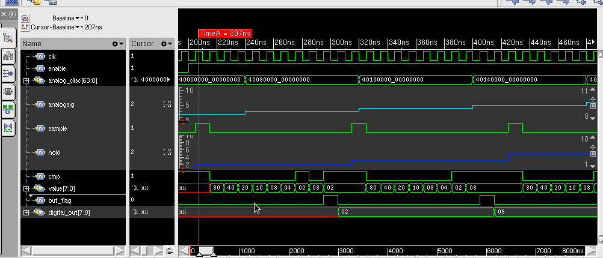
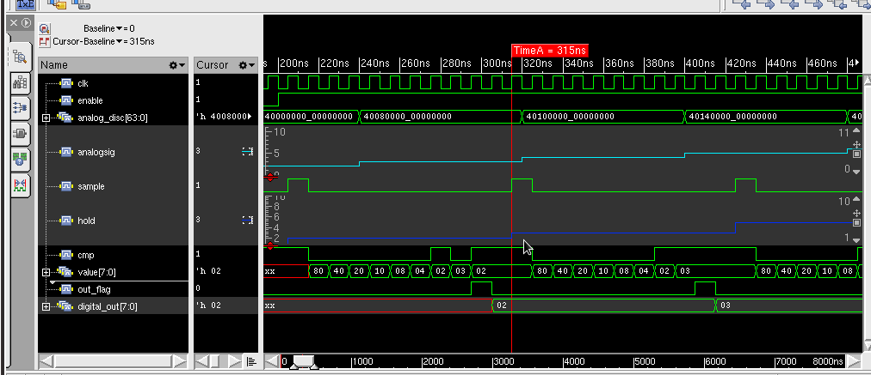

Slide 11
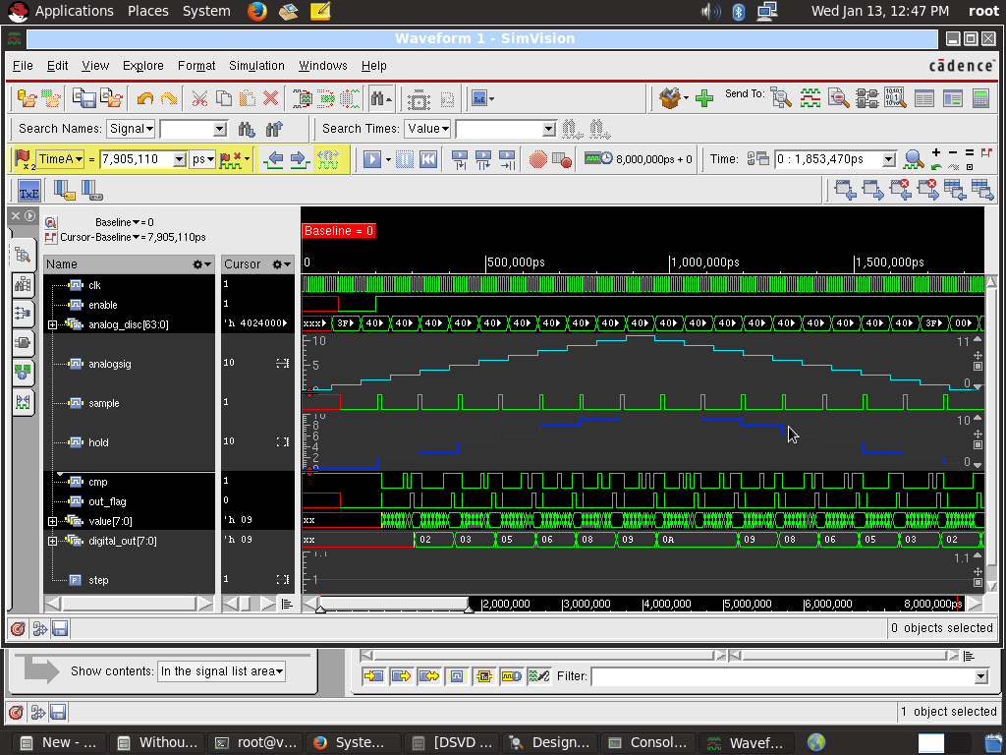
After synthesis:

Slide 12
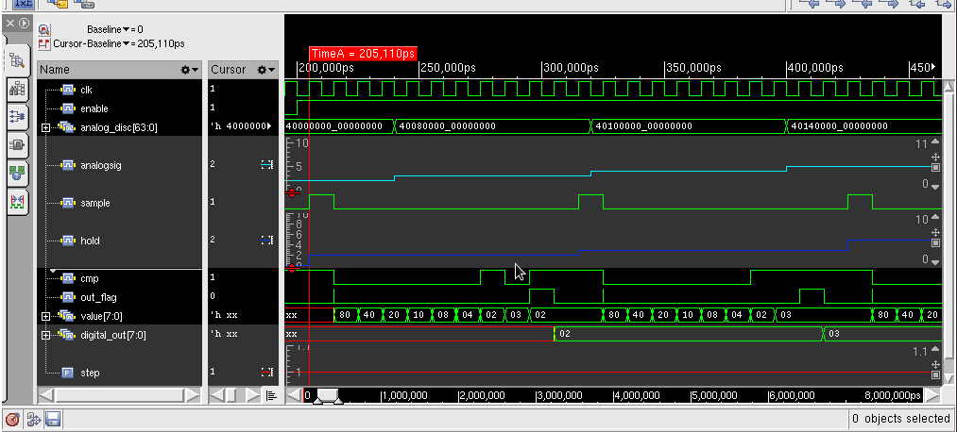
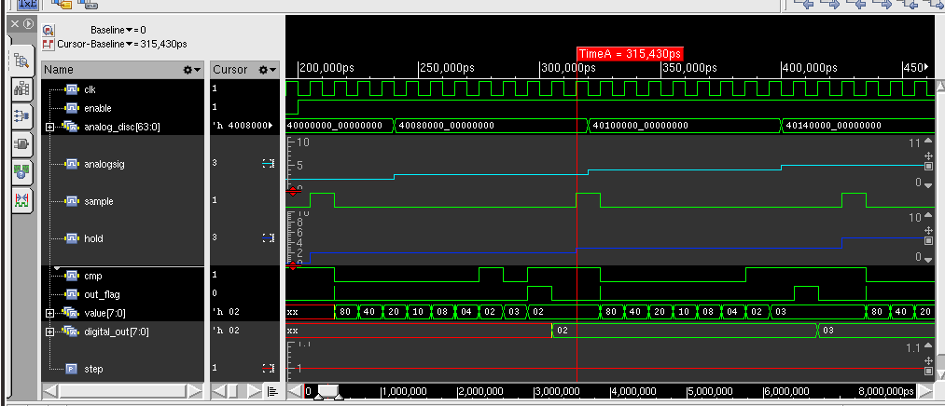

Slide 13
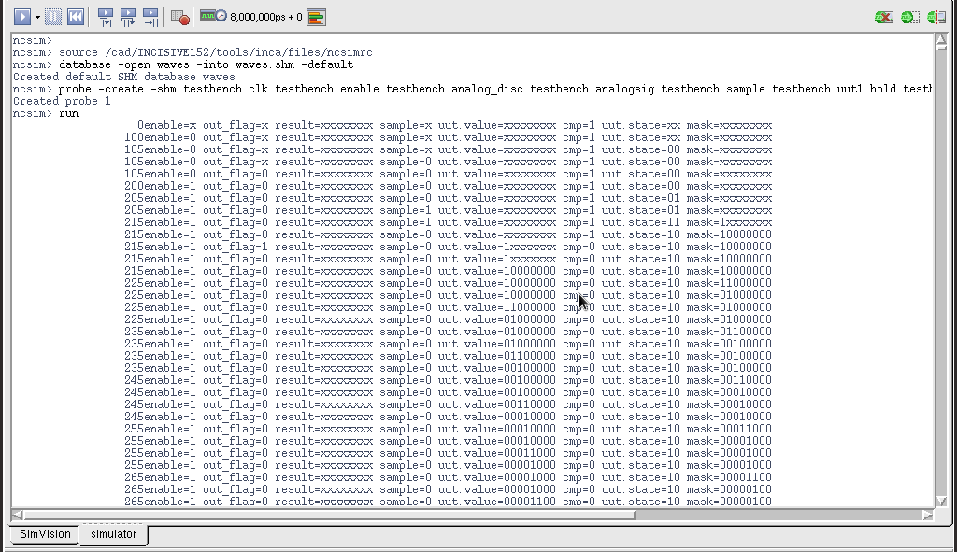

Slide 14
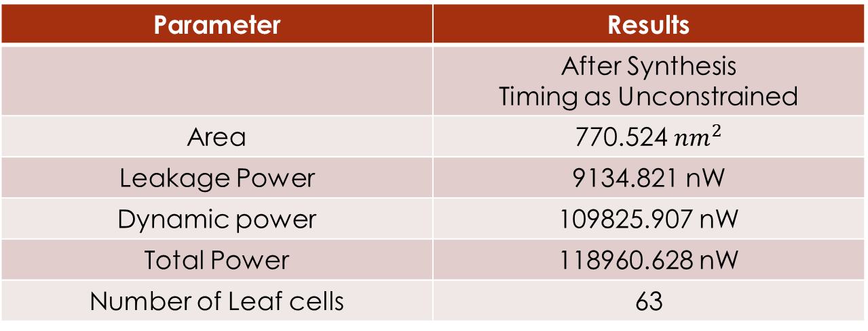
SAR ADC Implementation Results
Parameter | Results
 | After Synthesis Timing as Unconstrained
Area | 770.524 ${nm}^{2}$
Leakage Power | 9134.821 nW
Dynamic power | 109825.907 nW
Total Power | 118960.628 nW
Number of Leaf cells | 63

Slide 15
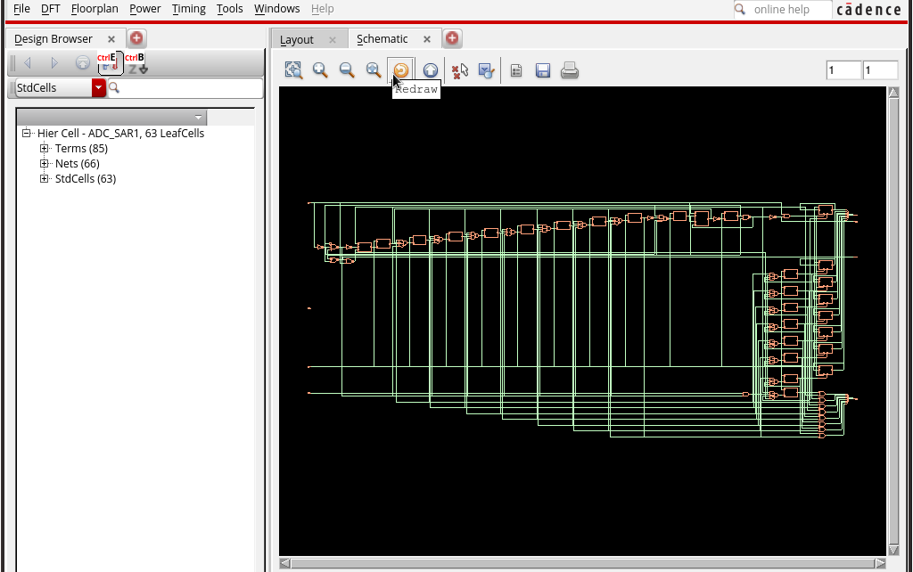

Slide 16
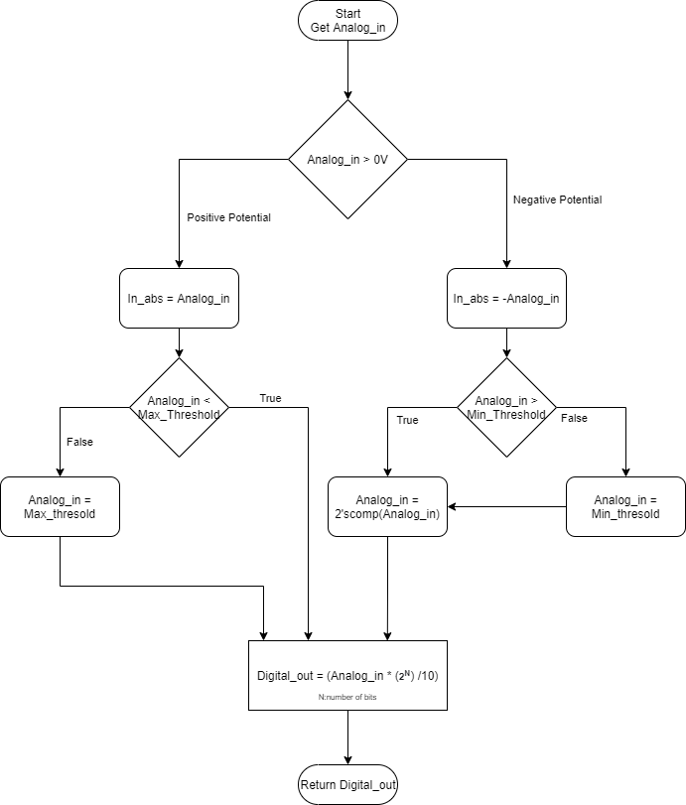
Flash ADC Implementation

Slide 17
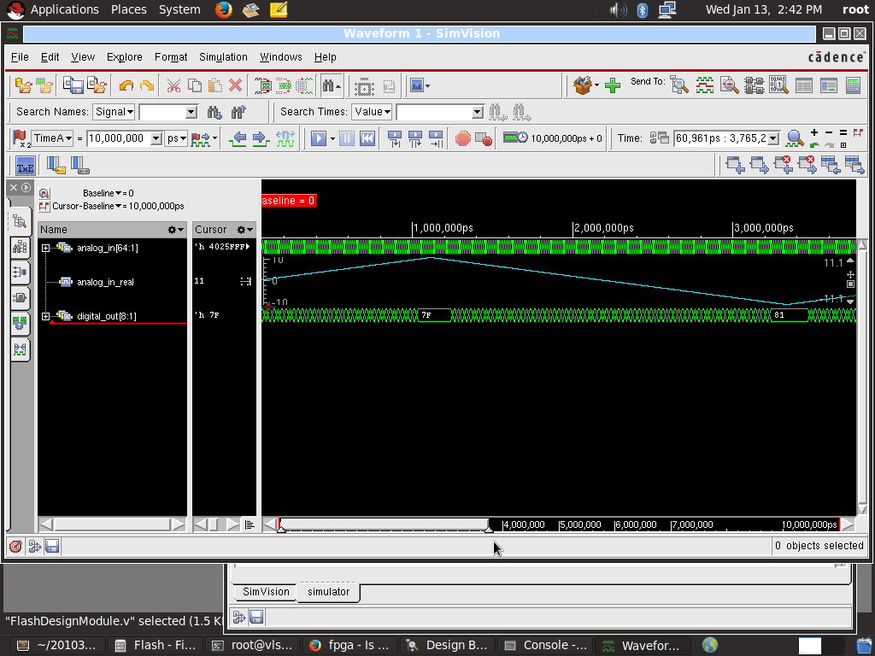
Results of Flash ADC

Slide 18
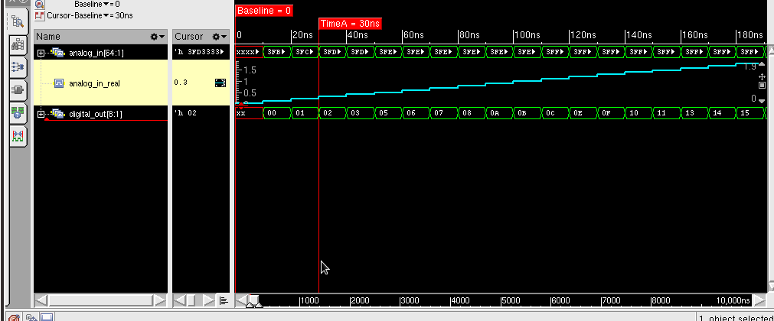

Slide 19
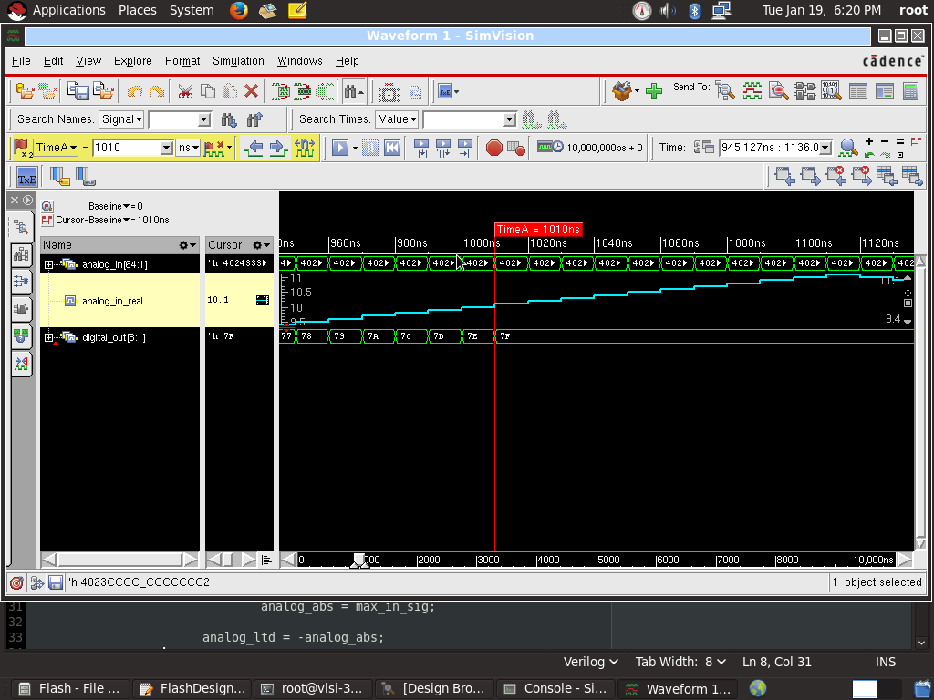
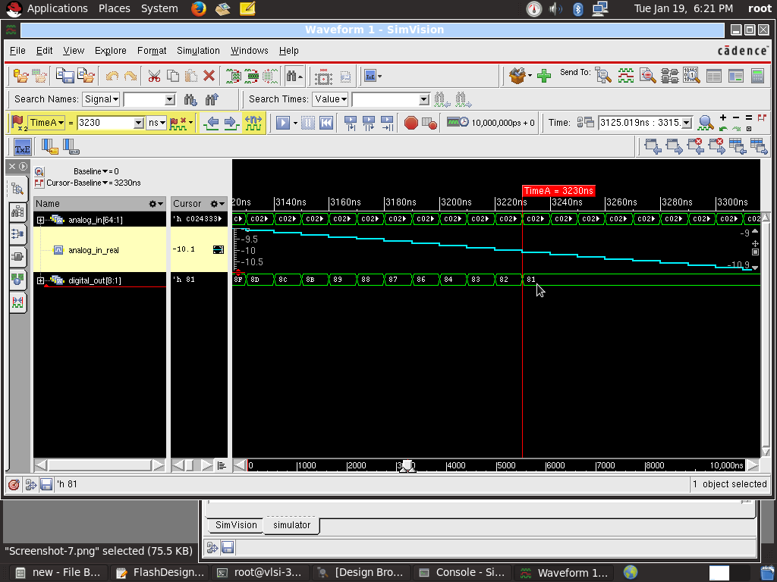

Slide 20
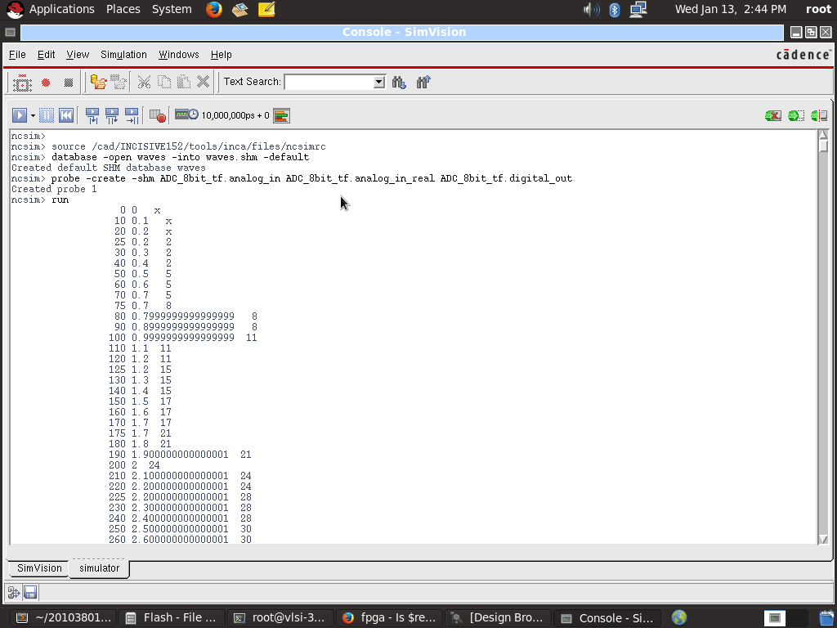
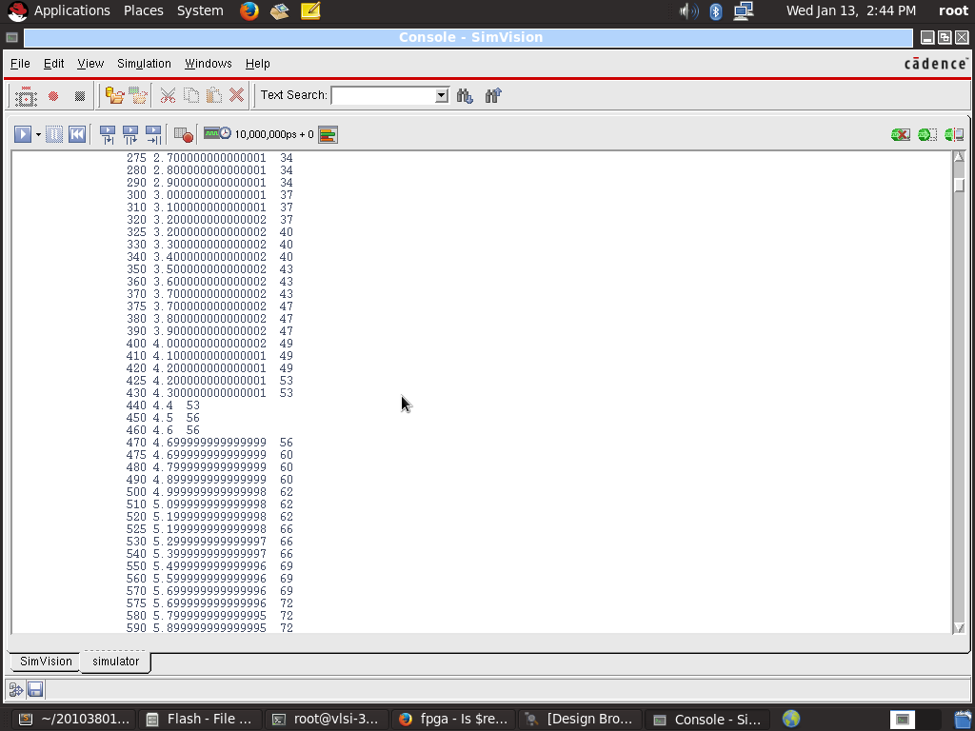

Slide 21
REFERENCES
https://components101.com/articles/analog-to-digital-adc-converters
https://pdfserv.maximintegrated.com/en/an/TUT810.pdf
https://www.allaboutcircuits.com/textbook/digital/chpt-13/flash-adc
https://www.maximintegrated.com/en/design/technical-documents/tutorials/1/1080.html

Slide 22
THANK YOU

Slide 23
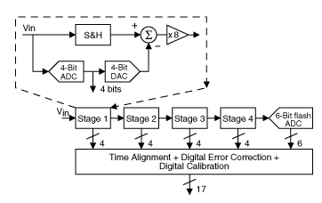
Pipelined ADC Architecture Block Diagram

Slide 24
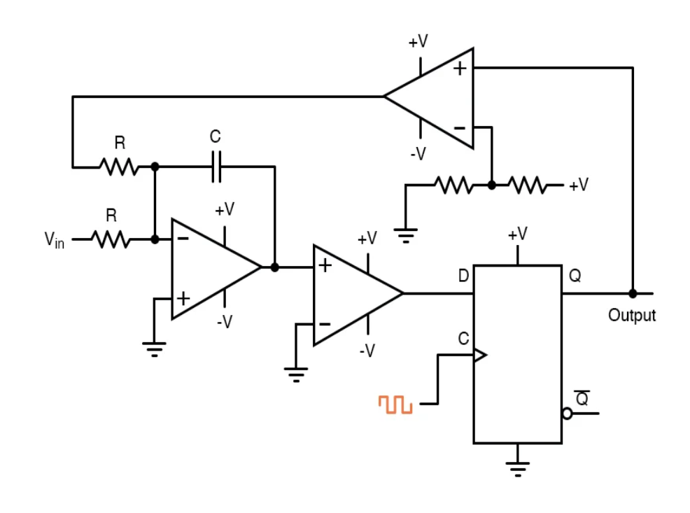
Sigma-Delta ADC Architecture Block Diagram

Slide 25
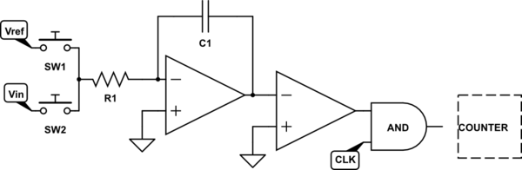
Dual Scope ADC Architecture Block Diagram

